Slide 1

GitLab guide
1
Copyright © 2019 Seco Tools AB

Slide 2


SAFETY FIRST
Safety is our top priority
Emergency Exit
Emergency Number
Alarm
Assembly Point
Protective Equipment
Psychological Safety*
*Psychological Safety means to include everybody in the meeting (including yourself), sharing knowledge, listen to other people and confirming their contribution.
Copyright © 2019 Seco Tools AB

Slide 3
Covid-19 prevention
Follow local/company Guidelines
stay home when feeling sick
Careful hand HYGIENE
physical Distancing
cough and sneeze correctly
AVOID TOUCHING YOUR FACE

Slide 4
GitLab
What:
GitLab is delivered as a single application, fundamentally changing the way Development, Security, and Ops teams collaborate and build software. From idea to production, GitLab helps teams improve cycle time from weeks to minutes, reduce development process costs and decrease time to market while increasing developer productivity.
Pros:
It allows us to collaborate, review code, manage projects, and monitor issues
GitLab is a great web-based Git repository tool.
Easy to manage pull and merge request
The onboarding process is very seamless as well. It is a tool that can be used by both a novice and an experienced developer.
Cons:
Sometimes, crashes happens and you need to restart the server.
Similar Repository: AWS Code Pipeline, TFS, GitHub, Bitbucket etc.

Slide 5
Git Best Practices
Who this guide is for This guide is for anyone in the Engineering organization looking to improve developer workflow and productivity, as well as code quality and security.

Slide 6
Create new repository for each project.
Creating new repository for new project will always keep reduce the dependencies between branches. Also, it will help while compilation and deployment of project individually.
The standard naming conventions should be followed while creating repository and branches.
The repository naming conventions should be maintained standard across all projects.
The branch structure should be used as below,
Default branch – main/master – it should be in small case. – Limited user access should be provided to this branch.
Dev/development – all the development commits should happen on this branch and then a pull/merge request should be created to master upon complete testing and validation of code.
Feature branch/local branch – This is the branch individual developer should create from dev/development branch and work individually. Then upon development complete create pull/merge request to dev/develop branch.
main/master
Limited people access & can not be deleted- Production Branch
dev/develop
Create feature branches from here and merge back changes in this branch only
Feature branch
Feature branch
Feature branch
Feature branch
Developer 1
Developer 2
Developer 3
Developer 4
Individual developer should develop on his own feature branch and create pull request to dev/develop branch

Slide 7
Use feature branches rather than direct commits on the main branch.
Using feature branches is a simple way to develop and keep the source code clean. If a team has recently transitioned to Git from SVN, for example, they’ll be used to a trunk-based workflow. When using Git, developers should create a branch for anything they’re working on so that contributors can easily start the code review process before merging.
Create daily/once in 2 days merge request to develop branch.
Developer should daily or once in 2 days commit their changes in feature branch and then create a pull request to develop branch. In pull request they should include code reviewer. Code review should happen for this pull request and then only merged to develop branch. Then delete the current feature branch and create new feature branch from develop for next development.
This will help –
Code review will be easy with limited code instead of full weeks code.
Defects will be identified early stages and easy to fix.
Merge conflicts will reduce for common functionality.
Developer will have all the latest code changes in new feature branch.
Don’t test everything at the end of a week or project. Code reviews should take place as soon as possible, because developers are more likely to identify issues that could cause problems later in the lifecycle. Since they’ll find problems earlier, they’ll have an easier time creating solutions.
Unit Testing and Building Automated test cases.
Make sure code is compiled and unit testing is performed on the code before creating pull request and merging of code. If possible, create Automated test cases project and run those test cases to identify functional and logical bugs.

Slide 8
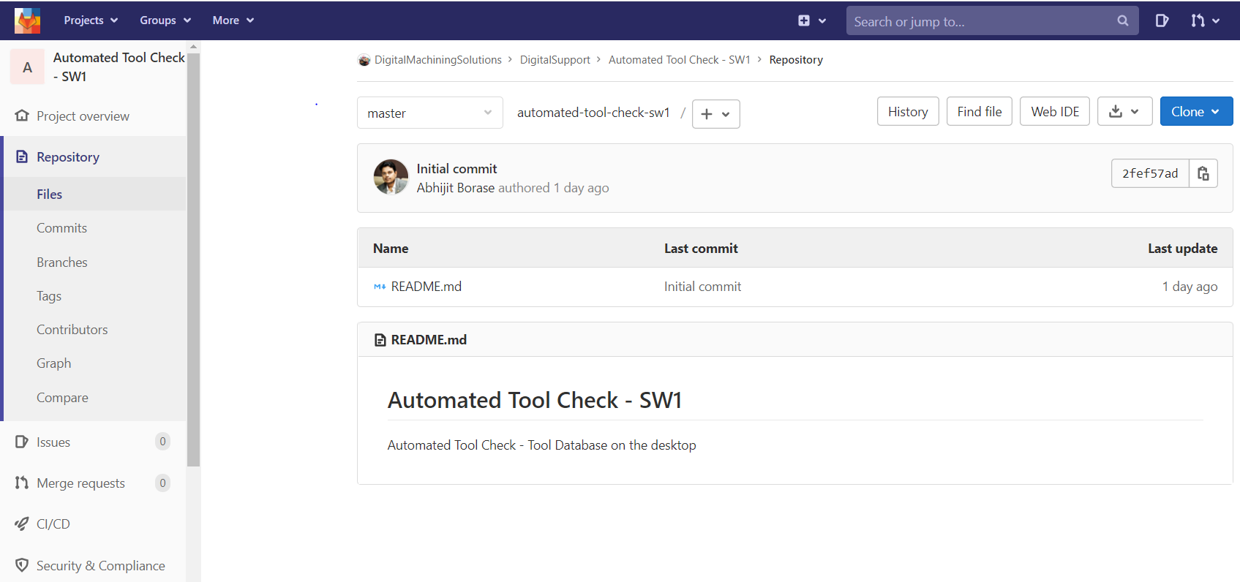
Repository (https://docs.gitlab.com/ee/user/project/repository/)
A repository is where you store your code and make changes to it. Your changes are tracked with version control.
Each project contains a repository.

Slide 9
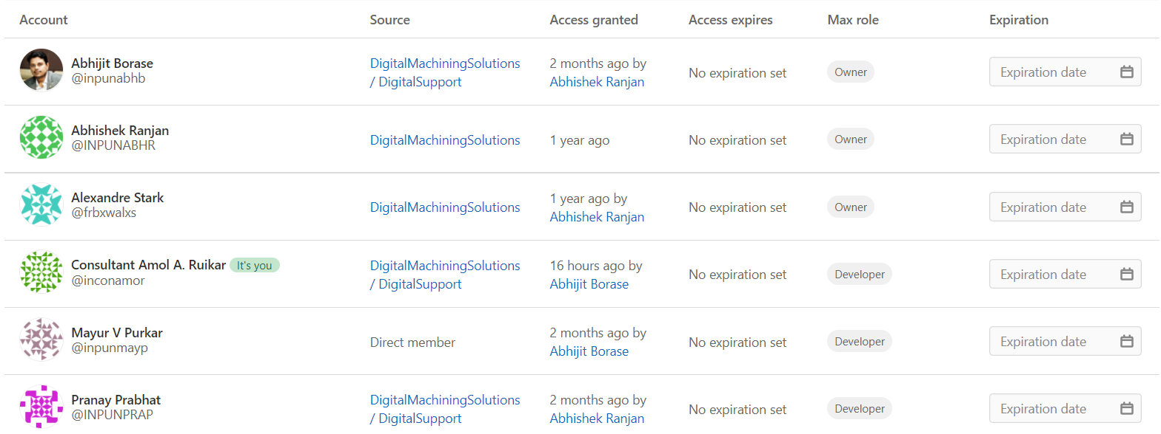
Administration Of Repository
Identify team members and provide appropriate level access to repository. You can find details of roles and permissions in below link,
https://docs.gitlab.com/ee/user/permissions.html

Slide 10
Steps to Add GitLab extension in Visual Studio
&
Clone the repository.

Slide 11
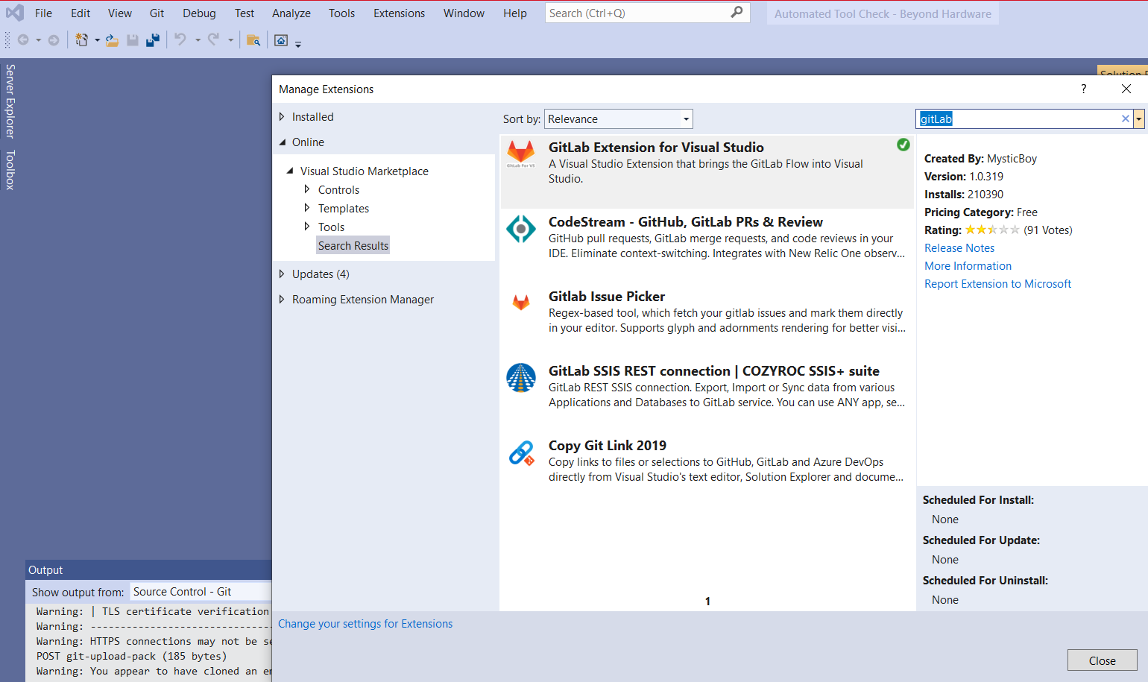
In Visual Studio first you need to install GitLab extension. Click on ‘Extensions’ as highlighted below.
In extension screen search ‘gitlab’ and the gitlab extension will get filtered. Click on download. The extension will get installed once you closed VS screen.

Slide 12
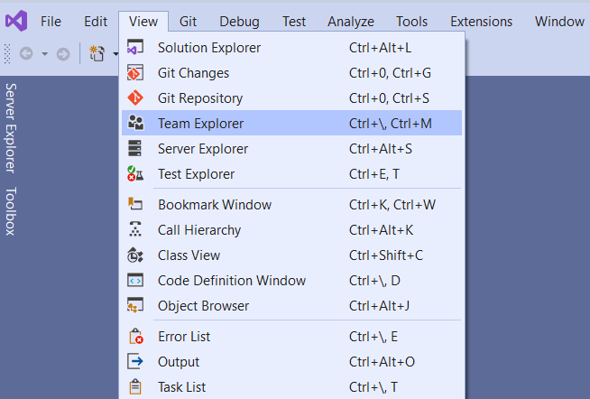
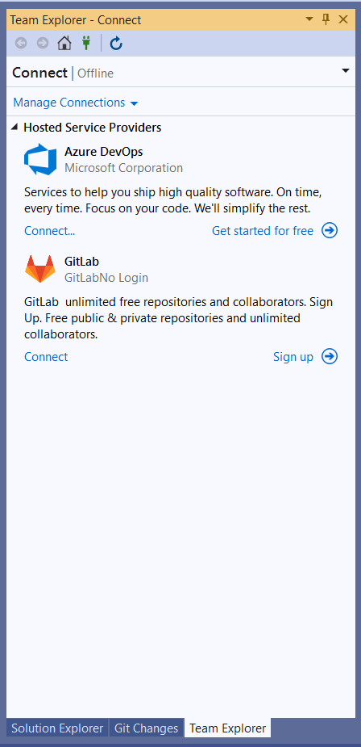
After extension installation, need to restart VS.
Once VS started as shown in screen go to menu to enable Team Explorer option. View→ Team Explorer.
On Team Explorer you will see the different provider options to connect with different types of repositories.
On GitLab you will see the ‘Connect’ option. This is one time activity to connect with GitLab repository from Visual Studio IDE. Click on it and a new window will open.

Slide 13
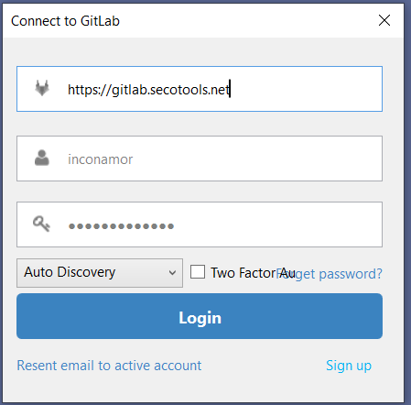
A new window with Connect to GitLab will open as shown.
In this please add the default GitLab path as below,
https://gitlab.secotools.net
The username will be the name with which you connect to GitLab in browser.
E.g. inconamor or inpunmayp
Use the password same as your system password or the password you use to connect to GitLab in browser.
Click On Login.

Slide 14
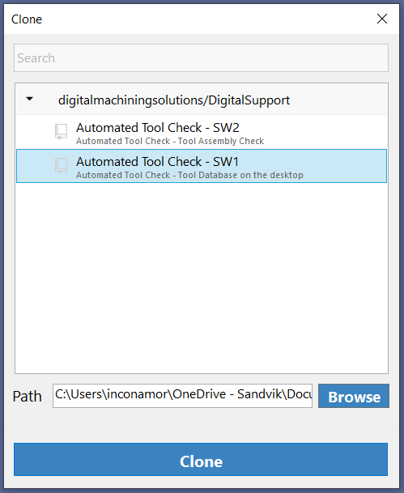
After successful login you will be able to see all the repositories to whom you have access.
You can select the repository and choose the local system folder where you want to clone the repository.
Then click on Clone button. The repository will start cloning from remote to your local system.
If in case, you got the below SSL certificate error while cloning, follow steps mentioned in next slide.
Git failed with a fatal error. unable to access 'https://gitlab.secotools.net/digitalmachiningsolutions/DigitalSupport/automated-tool-check-beyond-hardware.git/’: SSL certificate problem: self signed certificate in certificate chain

Slide 15
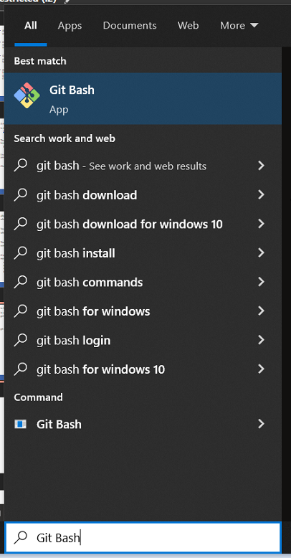
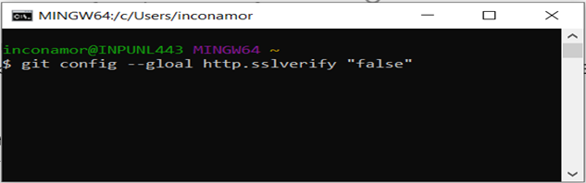
In case you face the SSL Certificate issue please follow below steps.
In windows search type Git Bash you can be able to see the option as shown in screen.
It will open a Git command window. Now type below command to disable SSL verification for GitLab on your system.
Teporory Solution :- git config --global http.sslverify “false”
Permanant Solution :- Installing SSL certificate
Restart the visual studio.
Repeat the septs from slide 9 to clone the repository.

Slide 16
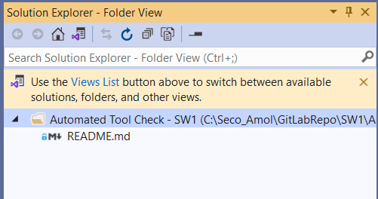
After successful clone in Solution Explorer, you will be able to see the Repository details.
To understand how to user Git options in Visual Studio refer the document. It will give details about branching, changes, pull, push, commit, stage, change branch details.

Slide 17

Thank you!

